Slide 1
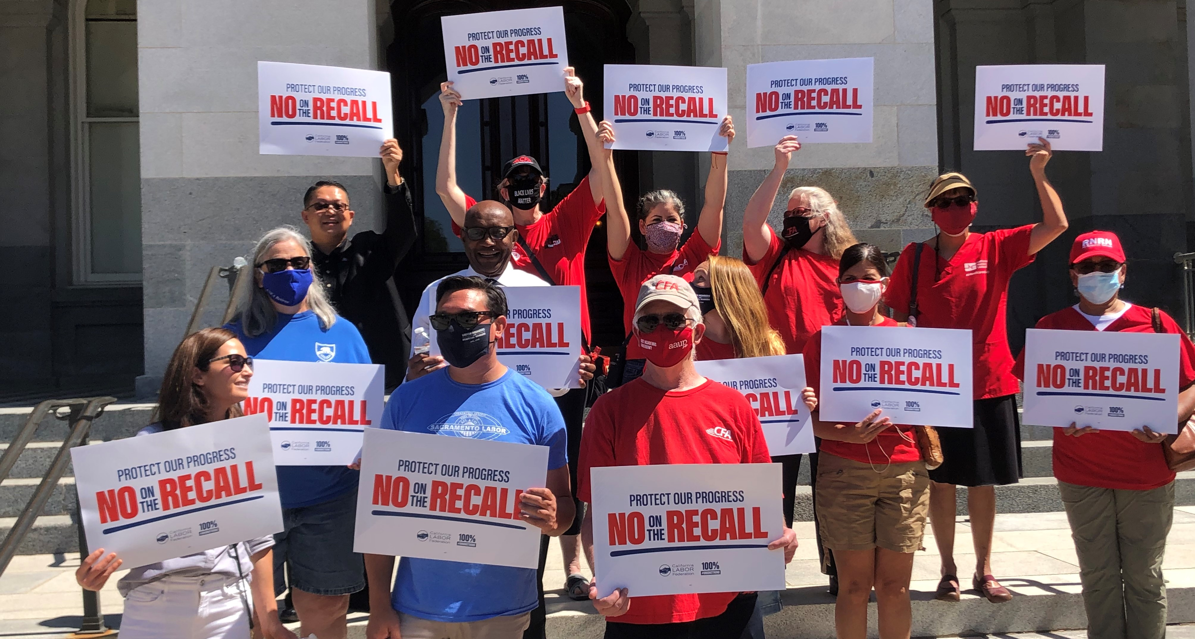

Slide 2
The recall election of Gov. Gavin Newsom threatens all the gains we’ve made on workers’ rights.
The recall puts at risk pro-worker laws and union priorities that have been in place for decades, well before Newsom was elected.

Slide 3
Who’s Behind the Anti-Union Recall?
Anti-union, anti-public education millionaires are bankrolling the recall election.
All the backers share one thing in common: They despise unions and want to limit worker power.

Slide 4
Recall Process and Timeline
The recall qualified for the ballot with over 1.5 million verified signatures.
Lt. Governor set the election date: September 14
Ballots are mailed mid-August.
The campaign to STOP THE RECALL starts NOW.

Slide 5
Who’s Behind the Anti-Union Recall?
Anti-union, anti-public education millionaires are bankrolling the recall election.
All the backers share one thing in common: They despise unions and want to limit worker power.

Slide 6
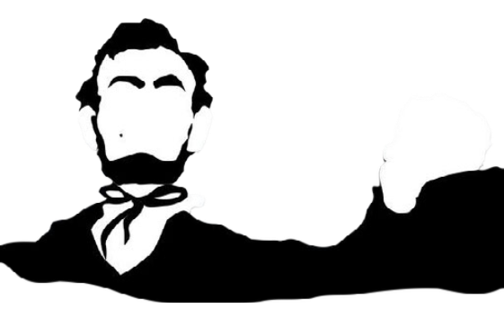
Who’s Behind the Anti-Union Recall
Lincoln Club of Orange County
California Policy Center
Trump Donors and Allies
Anti-Union Millionaires and Billionaires
Notes:
Lincoln Club of OC has been behind every major attack on unions for more than two decades, including the Prop 32 paycheck deception measure in 2012 and Prop 226 paycheck deception measure in 1998. The Lincoln Club funded signature gathering to recall Gray Davis in 2003. The groups is also anti-immigration and pro-Citizens United to allow for unlimited campaign donations from corporations.
California Policy Center – The CPC is part of a national network of right-wing, corporate-funded groups that push anti-union measures like right to work, the Janus decision that limits public sector union membership and scaling back the retirement security of public sector workers. The group has also been very active with an anti-public education agenda, pushing unaccountable charter schools and has ties to former Trump Education Secretary Betsy DeVos.
The recall backers include a number of wealthy donors to Donald Trump who push a MAGA agenda for California. Those donors include Geoff Palmer, a millionaire real estate developer who gave $7 million to Trump’s campaigns and hosted a fundraiser with Trump at his home. He’s also been accused of money laundering.
The recall funders include numerous anti-union millionaires and billionaires like former Arkansas Gov Mike Huckabee, former CA GOP chair Tom Del Beccaro and CEO Dennis Troesh

Slide 7
What’s at Stake with the Recall
EVERYTHING the labor movement has done to lift standards over decades.
Anti-union Republicans would control state agencies and have extraordinary influence over policy on worker issues.
Governor would have power to veto any legislation we pass to protect workers, raise wages and build stronger unions.

Slide 8
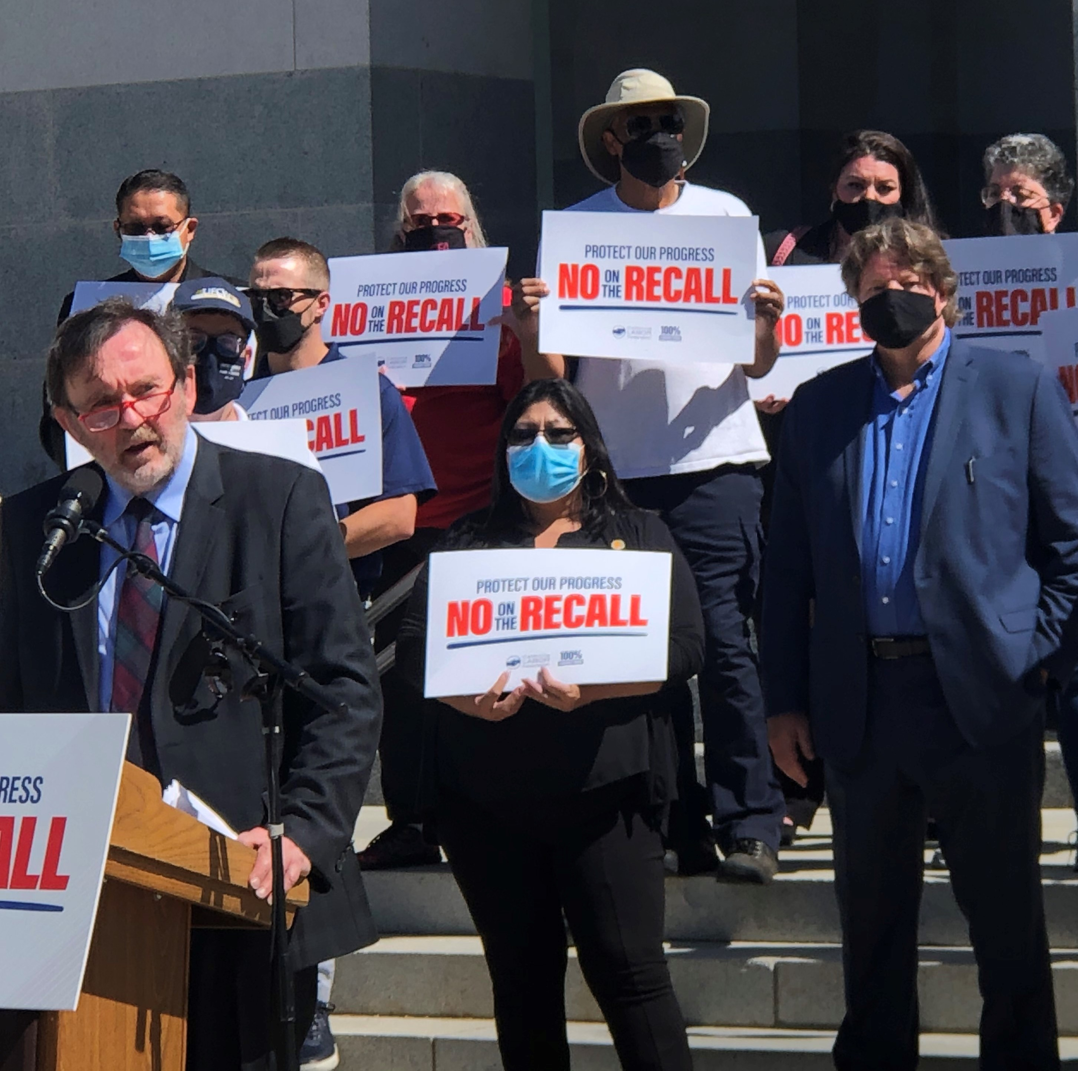
What’s at Stake with the Recall
Public education funding
Public sector jobs
$15 minimum wage
Worker pensions
The right to join a union
Corporate accountability
Workplace health and safety regulations
Immigrant worker rights
Union construction jobs and apprenticeships
Notes:
Even with a Democratic legislature in place, the Governor has broad powers to set policy in California. He can unilaterally issue executive orders and has enormous influence over state agencies like EDD. He can also propose and push massive budget cuts that lead to the loss of thousands of jobs and greatly reduced funding for public schools. He can even roll back the state’s $15 minimum wage without legislative approval

Slide 9
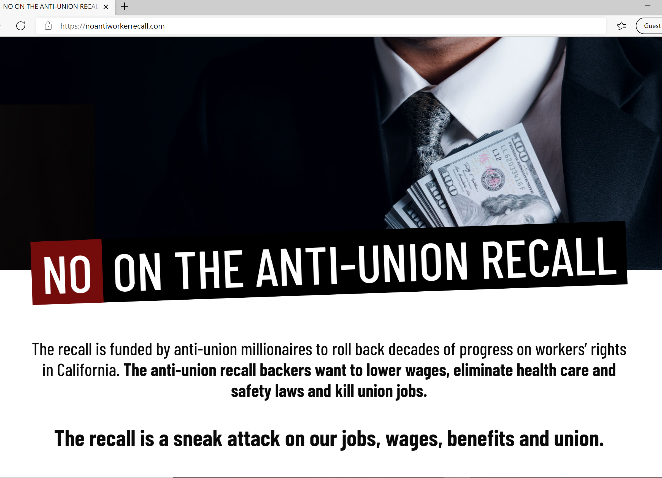
What’s at Stake with the Recall
Learn more at www.NoAntiWorkerRecall.com

Slide 10
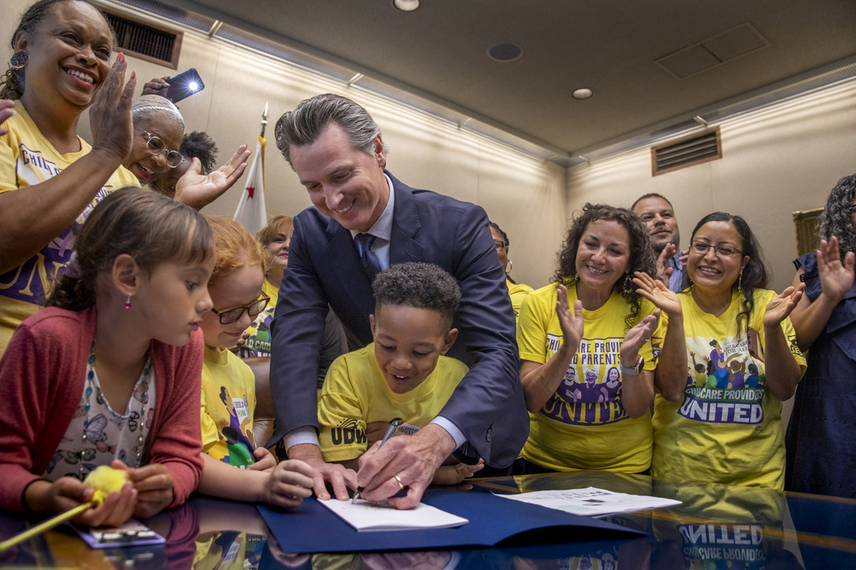
While we haven’t always agreed with the Governor, he’s signed critical bills that have advanced workers’ rights.
He partnered with Labor to get vaccines to essential workers.
The Governor’s door is always open to Labor and he’s been a ally on many issues we prioritize.
But this recall isn’t about any one individual. It’s about a direct attack on union values.
Notes:
Refer to https://governornewsomstandswithworkers.com/ for specifics on Gov’s record

Slide 11
Labor WILL Stop the Recall
In a low turnout special election, our efforts WILL make the difference.
We must connect with voters (especially our members) one-on-one through door knocking, worksite, phones, texts and digital.
Because we only have several months before Election Day, the campaign starts NOW.
Turning out union voters and base voters is the KEY to winning.

Slide 12
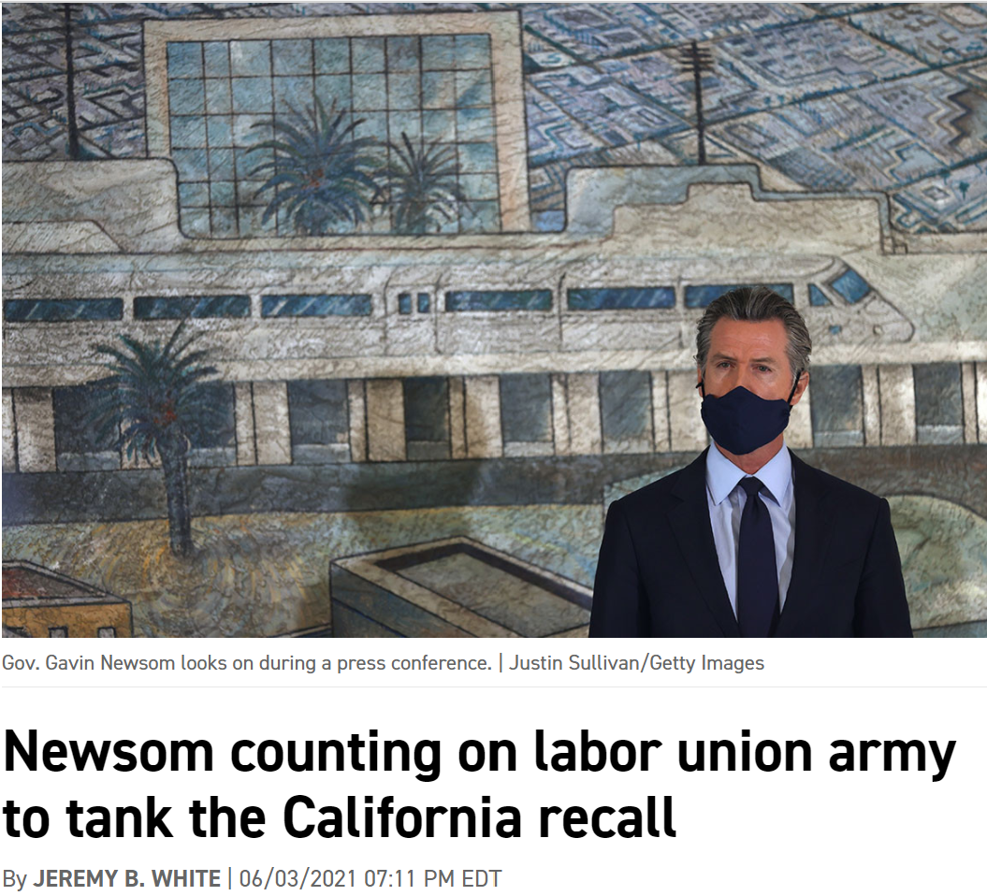
The Return of the Ground Game
Source: AP
“
With thousands of boots on the ground,
we will lead the charge to stop the recall
to protect decades of progress
”
on workers’ rights in California.
- Pulaski, 2021
Source: Politico

Slide 13
Mobilizing to Win
Connect with every union voter between now and September multiple times
Walks, phone banks, text banks, emails, union letters, worksite visits and more
Californians need to know what’s at stake with the anti-union recall!

Slide 14
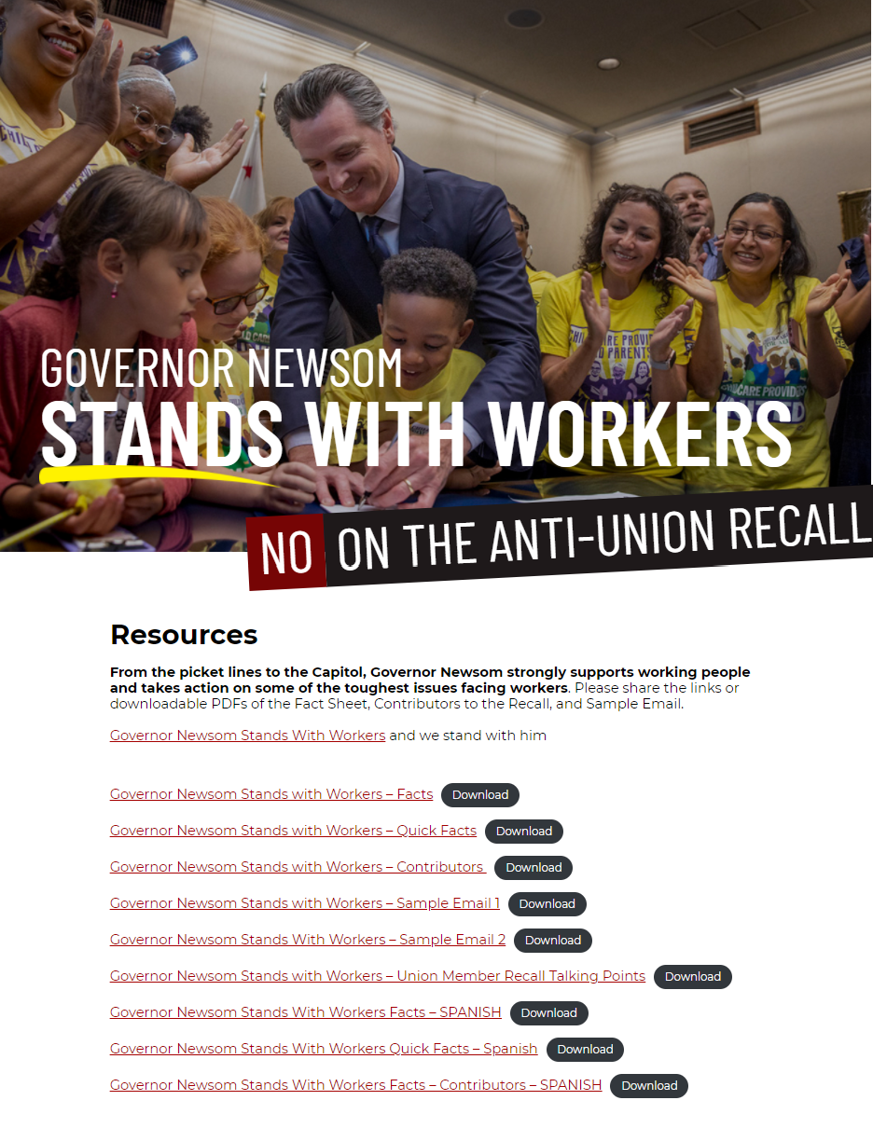
Mobilizing to Win
www.GovernorNewsomStandsWithWorkers.com/Resources/

Slide 15
Contact info
Steve Smith, Communications Director,
ssmith@calaborfed.org
Bryan Blum, Political Director,
bblum@calaborfed.org
Susan Sachen, Campaign Director,
ssachen@calaborfed.org

